Slide 1
INTRODUCTION TO SOFTWARE ENGINEERING

Slide 2
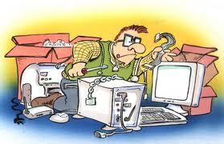
CBSE - Component Based Software Engineering

Slide 3
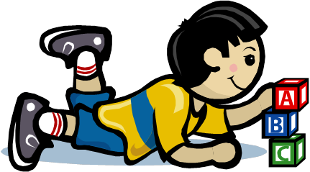
Lego
Set of building blocks in different shapes and colors
Can be combined in different ways
Composition through small stubs in one and corresponding holes in another building block
⇒ LEGO blocks are generic and easily composable
LEGO can be combined with LEGO, not with Meccano or any other blocks
Common Theme
Reuse
Quickly assemble Models
Build Complex models

Slide 4
What and why CBSE
What is CBSE
Component-based software Engineering approach is a reuse based approach to define, implement or select of-the shelf components and integrate/compose loosely coupled independent components into systems
Motivation or the need for CBSE
Increase in complexity of systems
Need for a quicker TAT .. So reuse rather than re-implement and shorten development time

Slide 5
Advantages and Problems with CBSE
Advantages of CBSE
Components could be used as a black box and hence reduces complexity of systems
Since developers reuse components, this reduces the development time
Increases quality (due to explicit dependencies, reuse) especially evolvability and maintainability
Increases productivity
Problems with CBSE
Component trustworthiness
Component certification
Emergent property prediction
Requirement trade off

Slide 6
Essentials of CBSE to be successful
Independent components that are completely specified by the public interfaces (implementation is hidden and hence can be changed)
Component standards that facilitate the integration of components
Middleware that provides software support for component integration
Development process that is geared up to CBSE (interleaving of requirement and system design –trade-off requirements/existing services etc.)

Slide 7
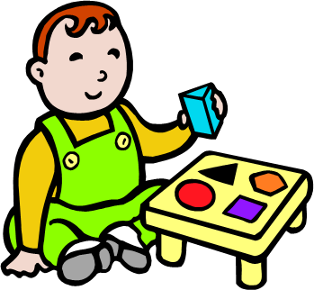
A Software Component
Implements a functionality without regard to where the component is executing or its programming language
Its an independent executable entity that can be made up of one or more executable objects;
The component interface is published and all interactions are through the published interface;
Has explicit dependencies through “required” interfaces and “provides” (the services that are provided by the component to other components)

Slide 8
Identifying the Software Component
Identifying the components could involve
Searching for the component
Selection of the component
If there are no ready component, Compose components with existing components to create component
It could be a sequential composition and additive or may need some adapters or “glue” to reconcile different component interfaces
Validate the component
Component Selection
Component Search
Select from Existing Repository
Component Validation
Component Building
Identify/Build
Adaptation for Component Characteristics
Standardization/ Validation/Verification
Component 1
Component 2
Component 3
Component 4
Component 5

Slide 9
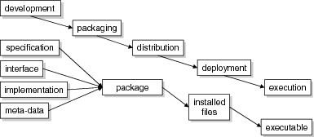
Component Development Stages
Across these stages, components are represented in different forms:
During development : UML etc.
When packaging : in a .zip file etc.
In the execution stage: blocks of code and data

Slide 10
Elements of a Component Model
Defines the types of building block, which can be composed with other components to create a software system
Interfaces : Defines how component can interact and also defines operation names, parameters and exceptions, which should be included in the interface definition
Usage : In order for components to be distributed and accessed remotely, they need to have a globally unique name or handle associated with them
Deployment : The component model includes a specification of how components should be packaged for deployment as independent, executable entities
Notes:
Specification describes properties to be realized: realization contract
Interface describes how components interact: usage contract
Different in scope as well: specification is about the component as a whole, while an interface might be about part of a component only
Interface defines how it needs to be defined ..that is operation names, parameters and exceptions in the interface definition
Metadata .. Since it can be accessed globally, a unique hierarchical name .. Provides an ability to discover the interfaces and attributes of the component for potential users
They have to be bundled together for independent executable entities .. Contents of package and its binary organization .. How components can be removed or replaced

Slide 11
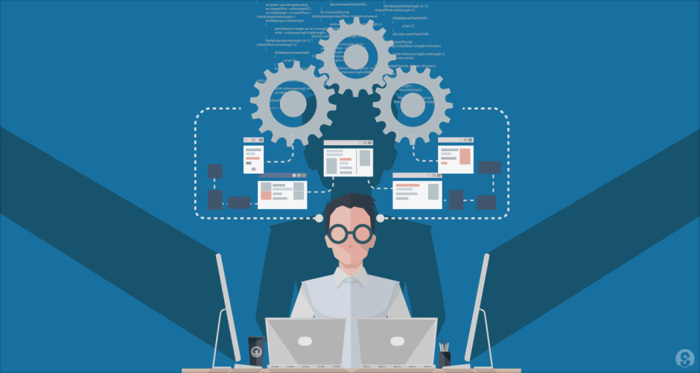
Service Oriented Architecture

Slide 12
Service Oriented Architecture
SOA is a software design methodology based on structured collections of discrete software modules, known as services, that collectively provide the complete functionality of a large or complex software application.
Its a logical representation of a repeatable business activity that has a specified outcome (e.g., check customer credit, provide weather data, consolidate drilling reports)
These could be implemented as discrete pieces of software or components written in any language capable of performing a task
These could be implemented as “callable entities” or application functionalities accessed via exchange of messages
These may also be application functionality with wrappers which can communicate through messages
Software is deployed “somewhere”, on-need basis .. SaaS

Slide 13
Service-oriented architecture (SOA)
A typical architecture contains an Orchestration/coordination layer, business service layer and infrastructure service layer or the service composition layer. There also exists a Service bus through which the communication takes place
Orchestration/coordination layer
service bus
physical
Discrete Software pieces Developed in any language
/Wrappers for legacy apps
logical
Business services layer
communication
service
- Contains services for Business logic
service
Infrastructure service layer
service
- Contains supporting activities storing Shipping of data
service

Slide 14
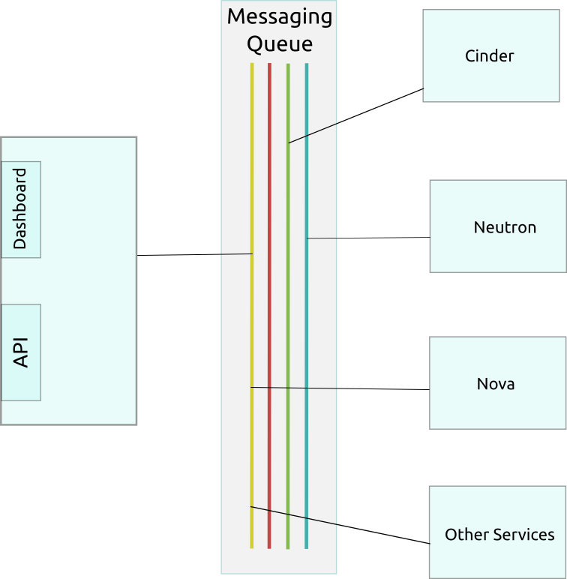
Example : Openstack

Slide 15
Product Lines

Slide 16
Motivation for Product Lines
Size & Complexity
Architecture
Quality
Product
Lines
Diversity
Reuse
Components
Lead Time
Reduction

Slide 17
Software Product Line Engineering
So Reuse is an imperative
Software product lines refers to engineering techniques for creating a portfolio of similar software systems from a shared set of software assets
A product line represents a family of manufactured products
A product line architecture explicitly captures the commonality and variability of a product line components and their compositions
Software Product Line Engineering makes it possible to
create software for different products
use variability to customize the software to each different product
Notes:
Product family :
Is a set of products with many commonalties and few differences.
Is intra-organizational.
Product Line:
Is a top-down, planned, proactive approach to achieve reuse of software within a family (or population, see the next section) of products.

Slide 18

Key Drivers for effective product lifecycle Re-Use :
Software product lines enhance reuse through predictive software reuse (rather than opportunistic)
Software artifacts are created when reuse is predicted in one or more products in a well defined product line
These artifacts could be built as components which are reusable or could be looked at as design patterns which could be built using some fine grained components for a particular solution

Slide 19
Product Line Engineering Framework
Product Management
Domain Engineering: Define and realize the commonality and variability
The goal is to establish a reusable platform
Domain Engineering
Product Management
Domain Requirements Engineering
Domain Design
Domain Realisation
Domain Testing
Application Engineering: Reuse domain artifacts, exploiting variability to build a product. The goal is to derive a product from the platform established in the Domain Engineering phase
Domain Artefacts incl. Variability Model
Requirements
Architecture
Components
Tests
Application Engineering
Application Requirements Engineering
Application Design
Application Realisation
Application Testing
Application N – Artefacts incl. Variability Model
Application 1 – Artefacts incl. Variability Model
Requirements
Architecture
Components
Tests
Based on the “Software Product Line Engineering” book by Klaus Pohl, Günter Böckle and Frank J. van der Linden
* All credits go to an IBM presentation on the Internet from where this has been leveraged

